Slide 1
State of Nevada Department of Health and Human Services Division of Child and Family Services Amber l. howell, administrator

Slide 2
Organizational Structure
DEPARTMENT OF HEALTH AND HUMAN SERVICES DIVISION OF CHILD AND FAMILY SERVICES 2015-2017 BIENNIUM
Amber L. Howell
Administrator
ahowell@dcfs.nv.gov
Josh Noble
Executive Assistant
Jnoble@dcfs.nv.gov
Danette Kluever
Deputy Administrator
Administrative Services
dkluever@dcfs.nv.gov
Jill Marano
Deputy Administrator
Child Welfare Services
jmarano@dcfs.nv.gov
Chrystal C. Main
Systems Advocate
cmain@dcfs.nv.gov
Kelly Wooldridge
Deputy Administrator
Children’s Mental/ Behavioral Health
kwooldridge@dcfs.nv.gov
Steve McBride
Deputy Administrator
Juvenile Justice Services
smcbride@dcfs.nv.gov
Information Management
Child Welfare
Policy Development
Southern Nevada Child and Adolescent Services
Youth Parole
Services
Fiscal Support
Rural Child Protective and Welfare Services
Northern Nevada Child and Adolescent Services
Caliente Youth Center Nevada Youth
Training Center
Grants Management
Child Welfare Training and Quality Improvement
Wraparound In Nevada
Summit View Youth Correctional Center/
Red Rock Academy
Mental Health Planning and Evaluation

Slide 3
Summary of Agency Operations
Division of Child and Family Services (DCFS) is responsible for child protective and welfare service delivery in rural Nevada and oversight of urban county-operated child protective and welfare services; children’s mental/behavioral health treatment and residential services (outpatient and inpatient acute) in urban Nevada; and, statewide juvenile justice services including state-operated youth training centers and youth parole. A non-exhaustive list of DCFS’ program areas includes:
Administrative and Other Services: child protective and welfare quality assurance/improvement and oversight, information management, central office fiscal support, personnel services, systems advocate services and grants management. Budgets include 3143 UNITY/SACWIS; 3145 Children, Youth and Family Administration; and 3181 Victims of Domestic Violence.
Children’s Mental/Behavioral Health Services: screenings and evaluations, early childhood services, outpatient therapy, wraparound case management and residential and inpatient/acute treatment services and mobile crisis. Budgets include 3281 Northern Nevada Child and Adolescent Services (NNCAS) and 3646 Southern Nevada Child and Adolescent Services (SNCAS).
Child Protective and Welfare Services: clinical and case management services and programs that respond to caregiver maltreatment/abuse of children and children’s need to achieve permanency such as intensive family preservation services, foster care, adoption services and independent living services. Budgets include 3141 Washoe County Child Welfare Integration; 3142 Clark County Child Welfare Integration; 3229 Rural Child Welfare; 3242 Child Welfare Trust; 3250 Transition from Foster Care; and 3251 Child Death Reviews.
Juvenile Justice Services: youth rehabilitation, treatment and community safety, and youth commitment to state-operated juvenile facilities with behavioral health services and supervision of youth upon release to their communities (parole). Budgets include 1383 Community Juvenile Justice programs; 3147 Youth Alternative Placement; 3148 Summit View Youth Correctional Center (SVYCC); 3179 Caliente Youth Center (CYC); 3259 Nevada Youth Training Center (NYTC); and 3263 Youth Parole Services.

Slide 4
Mission Statement
The Division of Child and Family Services (DCFS), together in genuine partnership with families, communities and county governmental agencies, provides support and services to assist Nevada’s children and families in reaching their full human potential. We recognize that Nevada’s families are our future and families thrive when they:
Live in safe, permanent settings.
Experience a sense of sustainable emotional and physical well being.
Receive support to consistently make positive choices for family and common good.

Slide 5
Vision
CHILD WELFARE
Strengthen and reinforce safety practices by continuing the implementation of Nevada’s safety assessment model and increasing consistency of the intake process by centralizing and standardizing and increasing the quality of case plans and goals.
Preserve connections and strengthen relationships by enhancing the capacity of child welfare staff to effectively engage children, youth and families in case decision making, creating a culture that values and supports the development of relationships between caseworkers and family members and recognizes the behavioral change process.
Expand service options and create flexibility for services to meet the needs of children and families by increasing the array of foster homes and treatment services available to children and families; and, strengthening foster parent skills.
CHILDREN’S MENTAL HEALTH
Provide comprehensive mental health services for children and adolescents who are unable to access these critically-needed services elsewhere due to lack of insurance coverage or lack of capacity in the private sector and to meet the needs of youth under the Medicaid system.
Improve and restore a child’s functioning at home, in school and in the community, thus preserving families and reducing the number of children entering the child welfare and/or juvenile justice system.
Promote safety and well-being in the community by providing crisis assessment and intervention for children and adolescents and monitoring psychiatric care in acute care facilities.
JUVENILE JUSTICE
Provide a comprehensive array of services to delinquent youth and their families which address their identified needs while maintaining community protection by holding youth accountable for their actions through community based, correctional and aftercare interventions.
Provide services and support to assist Nevada’s youth and families in reaching their full potential through a consistent, statewide continuum of care. Build strong communities through the strengthening of families, promoting family engagement at every level of service and intervention.
Promote positive value change for youths committed to the State of Nevada for correctional care due to delinquent offenses through a balanced, team-centered approach to service delivery.

Slide 6
CHILD WELFARE

Slide 7
Nevada’s Child Welfare system
Child welfare in Nevada up until 2001 was bifurcated. The two urban counties (Las Vegas and Reno) were responsible for the FRONT END type services: Intake, investigations, removal and the State was responsible for the BACK END type services such as Foster Care and/or Adoption.
In 2001, the Legislature changed this design of child welfare to a system where those counties that had populations of 100,000 or more were responsible for child welfare services and the State was responsible for the counties who had populations of less than 100,000.
Nevada has three child welfare agencies
DCFS supervises and administers child welfare services in the 15 rural counties.
Nevada uses a state-supervised, county-administered structure for the management of child welfare services.
Further, DCFS has state oversight for county-administered child protective and child welfare services delivery providing technical assistance, fiscal oversight for federal monies, and quality improvement activities.
Notes:
Child Welfare systems have historically functioned in a nationally unique “bifurcated” manner. Nevada has 17 counties, two of which possess population bases of over 100,000 persons: Washoe (Reno) and Clark County (Las Vegas). Historically, Washoe and Clark Counties supervised and administered child protective services, while the State’s DCFS supervised and administered statewide foster care and adoption services, as well as all residential therapeutic care. DCFS also supervised and administered both child protective and child welfare services in the 15 rural counties. In 2001, the Nevada State Legislature determined that the bifurcated system was not conducive to promoting positive outcomes for children and families. Through passage of the Legislature’s Assembly Bill 1, the transfer of state foster/adoption care services from the state to the counties with populations exceeding 100,000 (Clark and Washoe) counties was mandated. The state transferred child welfare foster care/adoption services and staff to Washoe County Department of Social Services (WCDSS) in January 2003. The transfer of staff and services to Clark County Department of Family Services (CCDFS) was completed in October 2004. DCFS remains responsible for supervising and administering child protective/welfare services in the remaining 15 rural counties.
Child Welfare Agencies provide a continuum of services. During the 2011 legislative session, Senate Bill 447 was passed which provides for DCFS to award block grants, categorical grants and to administer a program to award incentive payments to Clark County Department of Family Services and Washoe County Department of Social Services. More here about the block grant?

Slide 8
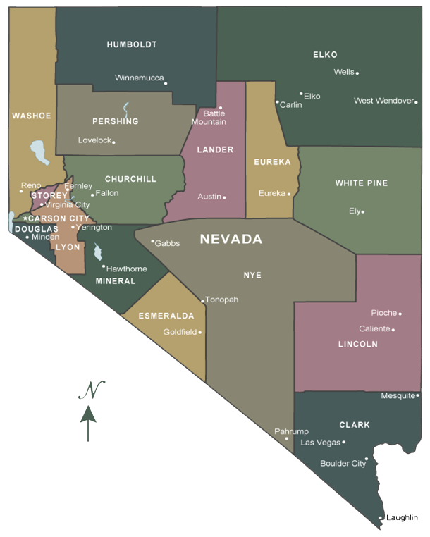
Child Welfare Agencies

Slide 9
State funding
In the 2011 Legislative session the funding for the two urban counties, Washoe County Department of Social Services (WCDSS) and the Clark County Department of Family Services (CCDFS) by the Division changed. Today, CCDFS and WCDSS receive an annual capped block grant each year to support child welfare services. The block grant is divided into two allocations:
A base allocation for each biennium which is based on the total State General Fund appropriated for the previous biennium. The base allocation may be used for the delivery of child welfare and child protective services without category restriction. Any unspent State General Funds remaining in the base allocation at the end of the fiscal year may be retained and reinvested for the delivery of child welfare and child protective services.
This requires the urban counties to meet a minimum maintenance of effort requirement. Specifically, the counties must maintain the amount of local funds spent for child welfare and child protective services at a level equal to or greater than the amount appropriated for fiscal year 2011.
A second allocation which would include the estimated cost attributable to projected caseload growth for the adoption assistance program. This was separated out of the block grant so there wasn’t a cap on adoptions to avoid de-incentivizing this permanency option for children. Caseloads will be discussed on the two next slides.
In addition to the block grant, the two urban counties are eligible to receive incentive funds to stimulate and support improvement in key areas identified in the agency improvement plan. In order to access incentive funding, the urban counties would be required to submit an application odd number years targeting defined improvement goals, resources needed to achieve the goals, established baseline data and stretch goals they believe they could achieve within a one year period the baseline data used including a description of the process they used to solicit public input.
If the urban county does not meet the targeted outcomes, the incentive award amount will be adjusted based on the applicable percentage of performance level achieved and the subsequent fiscal year's payment will be adjusted accordingly.
DCFS also funds the common core training

Slide 10
County Assessments
In the 2011 Legislative Session, SB 480 was enacted.
SB 480 requires an assessment of the rural counties for the cost of child protective services.
The assessment is determined based upon the percentage of the population for persons under 18 years old within each county. This assessment and percentage of the population is recalculated each year and notifications are sent out to each county prior to the upcoming fiscal year indicating the most recent amount due to the state.
A report on or before December 1 of each year is submitted to the Governor and to each county whose population is less than100,000 that contains a statement of:
(a) The total number of children who received child protective services in each county in the immediately preceding fiscal year; and
(b) The amount and categories of the expenditures made by DCFS on child protective services in each county in the immediately preceding fiscal year;
DCFS provides each county whose population is less than 100,000, on or before May 1 of each year, with an estimate of the amount of the assessment. The estimate becomes the amount of the assessment unless the county is notified of a change. The county is required to pay the assessment:
(a) In full within 30 days after the amount of the assessment becomes final; or
(b) In equal quarterly installments on or before the first day of July, October, January and April, respectively

Slide 11
CHILD WELFARE ASSESSMENTS
 |  |  |  |  |  | FY14 | FY15
BA3229 - RURAL CHILD WELFARE (CPS ASSESSMENTS TO THE COUNTIES) |  |  |  |  |  | $ 2,121,731 | $ 2,121,731
Carson City |  |  |  |  |  | 300,241 | 293,805
Churchill County |  |  |  |  |  | 170,533 | 170,190
Douglas County |  |  |  |  |  | 241,575 | 236,431
Elko County |  |  |  |  |  | 429,725 | 440,555
Esmeralda County |  |  |  |  |  | 3,510 | 3,482
Eureka County |  |  |  |  |  | 14,200 | 14,582
Humboldt County |  |  |  |  |  | 126,455 | 125,537
Lander County |  |  |  |  |  | 47,395 | 47,488
Lincoln County |  |  |  |  |  | 39,053 | 39,286
Lyon County |  |  |  |  |  | 350,789 | 349,792
Mineral County |  |  |  |  |  | 22,725 | 22,782
Nye County |  |  |  |  |  | 255,487 | 256,684
Pershing County |  |  |  |  |  | 35,680 | 35,170
Storey County |  |  |  |  |  | 20,574 | 20,818
White Pine County |  |  |  |  |  | 63,789 | 65,128

Slide 12
JUVENILE JUSTICE

Slide 13
A Bifurcated Juvenile Justice System
The State of Nevada, Division of Child and Family Services (DCFS), Juvenile Services, operates state youth correctional care and youth parole services
County level units of government operate juvenile detention centers, county based youth camps and juvenile probation.

Slide 14
State Juvenile Justice Services
Consists of Five Programs:
Caliente Youth Center-140 beds
Only state facility serving female offenders- 40 beds.
Serves younger, lower sanctioned male offenders- 100 beds.
Nevada Youth Training Center-60 Beds
Male youth housed at Nevada Youth Training Center are generally older and have more severe delinquent background than males housed at Caliente Youth Center. This is a medium staff secure facility.
Red Rock Academy at Summit View – 50 beds
The facility will be used for youth, who through the comprehensive assessment and classification process performed by the State, are too severe to be appropriately referred to the existing State operated facilities. Red Rock Academy is a contractual partnership between Rite of Passage and Nevada Division of Child and Family Services (DCFS). This facility has a capacity of 96 youth with DCFS contracting for 50 of those beds. This is a maximum secure facility.
Youth Parole Bureau
Youth, 12 to 21 years, who are committed to the Division of Child and Family Services for correctional and/or mental health care.
Supervise and assist youth released from a state correctional facility with reintegrating back into the community in which they reside.
Youth transferred to Nevada through the Interstate Compact on Juveniles.
Juvenile Justice Programs Office
Ensure that Nevada is in compliance with the four core requirements of the Office of Juvenile Justice and Delinquency Prevention.
Distribute grant funds to local jurisdictions through the Juvenile Justice Commission’s Grant Review Committee.

Slide 15
Case Flow
Arrest / Citation
Intake Assessment Unit (Misdemeanors)
Probation Assessment Unit
Court Diversion
Deferred Probation (informal)
Formal Probation
Suspended Commitment
County Youth Camps
China Spring
Aurora Pines
Spring Mountain
Private Providers
State Correctional
CYC
NYTC
Red Rock Academy
Adult Certification
Nevada Youth Parole Bureau

Slide 16
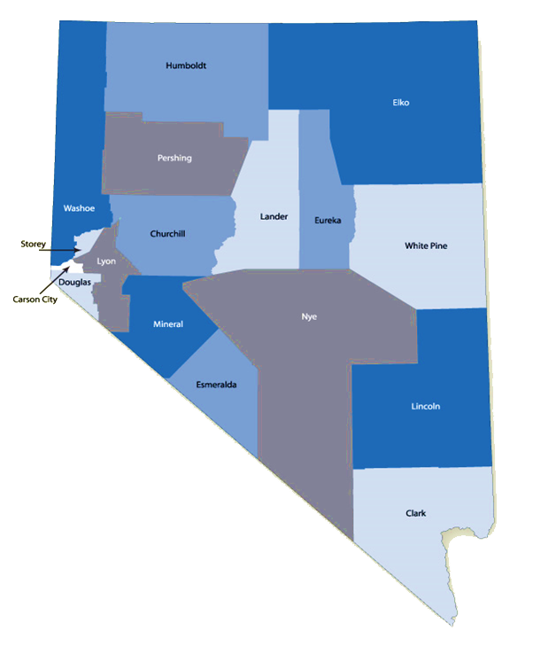
County Level
Nevada counties
Judicial Districts
1st-Carson/Storey
2nd-Washoe
3rd- Lyon
4th- Elko
5th- Mineral, Nye and Esmeralda
6th- Humboldt, Pershing and Lander
7th- White Pine, Lincoln and Eureka
8th- Clark
9th- Douglas
10th - Churchill

Slide 17
Youth Parole Assessments
In the 2011 Legislative Session, SB 476 was enacted.
SB 476 requires each county to pay an assessment for the activities of the Youth Parole Bureau that are necessary to carry out its duties.
The assessment owed by each county equals the total amount budgeted by the Legislature for the operation of the Youth Parole Bureau, divided by the total number of pupils enrolled in grades 7 through 12 in public schools
The Administrator of the Division of Child and Family Services shall calculate the assessment owed by each county in June of each year for the ensuing fiscal year.
Each county must pay the assessed amount to the Division of Child and Family Services in quarterly installments that are due the first day of the first month of each calendar quarter.

Slide 18
YOUTH PAROLE ASSESSMENS
 |  |  | 2011-2012 SCHOOL YEAR |  |  |  |  |  | Budget Account 3263
 |  |  | Enrollment by School |  |  |  |  |  | County Assessment for Youth Parole
 |  |  | Grades 7th - 12th |  |  |  |  |  | County Assessment = 1/2 of Leg Approved Budget
 |  |  | BOYS |  | GIRLS |  | TOTAL |  | 2,795,382 | 2,834,408
 |  |  | 7th - 12th |  | 7th - 12th |  | 7th - 12th |  | FY 2014 | FY 2014
 | Carson City |  |  |  |  |  | 3,522 | 1.83% | 51,209 | 51,924
 | Storey County |  |  |  |  |  | 198 | 0.10% | 2,879 | 2,919
 |  |  |  |  |  |  | 3,720 | 1.93% | 54,088 | 54,843
 | Washoe County |  |  |  |  |  | 29,269 | 15.22% | 425,566 | 431,507
 | Lyon County |  |  |  |  |  | 3,820 | 1.99% | 55,542 | 56,318
 | Elko County |  |  |  |  |  | 4,469 | 2.32% | 64,978 | 65,886
 | Esmeralda County |  |  |  |  |  | 14 | 0.01% | 204 | 206
 | Mineral County |  |  |  |  |  | 214 | 0.11% | 3,112 | 3,155
 | Nye County |  |  |  |  |  | 2,697 | 1.40% | 39,214 | 39,761
 |  |  |  |  |  |  | 2,925 | 1.52% | 42,529 | 43,123
 | Humboldt County |  |  |  |  |  | 1,506 | 0.78% | 21,897 | 22,203
 | Lander County |  |  |  |  |  | 525 | 0.27% | 7,633 | 7,740
 | Pershing County |  |  |  |  |  | 313 | 0.16% | 4,551 | 4,614
 |  |  |  |  |  |  | 2,344 | 1.22% | 34,081 | 34,557
 | Eureka County |  |  |  |  |  | 115 | 0.06% | 1,672 | 1,695
 | Lincoln County |  |  |  |  |  | 525 | 0.27% | 7,633 | 7,740
 | White Pine County |  |  |  |  |  | 640 | 0.33% | 9,305 | 9,435
 |  |  |  |  |  |  | 1,280 | 0.67% | 18,611 | 18,871
 | Clark County |  |  |  |  |  | 139,554 | 72.59% | 2,029,090 | 2,057,418
 | Douglas County |  |  |  |  |  | 2,994 | 1.56% | 43,532 | 44,140
 | Churchill County |  |  |  |  |  | 1,882 | 0.98% | 27,364 | 27,746
 | Total |  |  |  |  |  | 192,257 | 100.00% | 2,795,382 | 2,834,408

Slide 19
Recommendations made by the Commission on Statewide Juvenile Justice Reform
To date, the Commission’s objectives were to make recommendations for reform of the Juvenile Justice System in Nevada with greater emphasis on regionalization and programming. Major components of this transition involve state facilities and state general funds for deep-end commitments.
Phase I (2013 Legislative Session):
Downsized NYTC from 110 to 60 beds NYTC (160 bed capacity). Savings from this bed reduction was reinvested to reopen SVYCC.
Funding was approved to purchase 50 State correctional beds and the necessary equipment and start-up costs to move the Summit View Youth Correctional Facility to an operational level. DCFS accomplished this by contracting with Rite of Passage.
DCFS has isolated one full time position to act as the Quality Control Specialist to monitor the day to day operations of SVYCC programming.
Phase II (future)
The Commission analyzed several different Options, finally narrowing down to 3:
Option A. “Nevada T” Juvenile Facility: Design and construct a new secure Juvenile Correctional Facility for 56 beds at Summit View (Red Rock Academy) to house serious juvenile offenders who have historically been in the adult prison system: $15,461,937
Option B. Invest in NYTC long term Concept: Capital Improvement Projects would total: $6,021,023
Option C. Northern Nevada Regional Center (NNCC) Concept (this would trigger the closure of NYTC): Programming, Design, Bid and Construct a new 84 Bed Youth/Juvenile Facility at the Northern Nevada Correctional Center in Carson City. $44,322,213
The Commission voted (after Agency Request was closed) to recommend the following:
Designate NYTC as the juvenile commitment/treatment facility for the Northern Nevada Region at a 60 bed capacity long term.
NYTC receive funding for reasonable prioritized capital improvement projects directly related to the functioning and support of the 60 bed commitment/treatment program and that a full evaluation of the facility be completed to determine which buildings would not be used as part of the routine facility dynamic.
Abandon the Nevada T and NNCC Options.
NYTC CIP’s vs. Nevada T: Reduced CIP funding: $9,440,914
NYTC CIP’s vs. NNCC : Reduced CIP funding: $38,301,190
China Spring/Aurora Pines (CS/AP) and Spring Mountain Youth Camp (SMYC) receive funding to enhance their programming and Capital Improvement Needs
CS/AP Request SMYC Request
Programming: $788,367 Programming: $604,000
CIP’s: $5,503,000 CIP’s: Nothing submitted
AND allocate funding, to the local probation departments for community based programs such as, resiliency development, prevention/
diversion, Adolescent Substance Abuse, Juvenile Sex Offender Treatment, Assessments, Intensive Supervision, Behavioral and Mental Health Services and Evening Reporting Centers. Initial requests are totaling $3,400,000 per year.

Slide 20
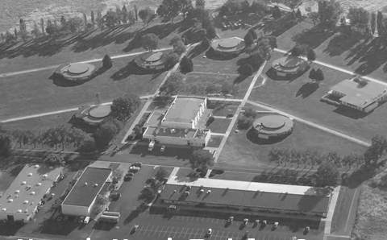
Recommendations made by the Commission on Statewide Juvenile Justice Reform
Aside from CIP’s the commission is recommending upgrades to the NYTC property and programming:
That NYTC provide a quality assurance component that will ensure compliance with all of the policies, procedures and general health, safety and welfare matters at the facility. Estimated at $114,975 (salary + benefits)
Enhance NYTC programming (Substance abuse, mental health, domestic violence, educational needs). (Costs unknown)
NYTC receive the necessary funding to bring back the Nevada Interscholastic Athletic Association (NIAA) sanctioned sports programs and opportunities to Independence High School including transportation costs, uniform costs, and equipment costs necessary to support a positive athletic experience. $48,000 first year, $30,000 each year thereafter.
Enhance visitation for families. NYTC should complete a full cost analysis of and be approved for a Family Systems Program, on grounds and in Northern Region communities, including transportation to and from the NYTC facility. Keeping in line with the supporting family systems improvement. BA 3259 includes an increase to include transportation costs in agency request in the amount of $36,802 per year
Ability to contract for a Psychologist position to solve recruitment/retention issues.
To accomplish this, DCFS would need to explore telemedicine as well in response to the lack of clinical psychologists in the Elko community. Estimated contract amount:$90,060. Telemedicine would also require increased Bandwidth.
Increase funding to address painting needs exterior and interior, flooring, furniture, cosmetic type enhancements. The facility has not been given much attention over the years due to its uncertain future. It needs to receive some improvements other than safety CIP’s to provide an environment that is better for youth. Estimated at $300,000.

Slide 21
Mandates
PREA COORDINATION AND IMPLEMENTATION
PREA (Prison Rape Elimination Act) Compliance. The Prison Rape Elimination Act of 2003 was enacted by Congress to address the problem of sexual abuse of persons in the custody of U.S. correctional agencies. The National Institute of Corrections has been a leader in this topic area since 2004, providing assistance to many agencies through information and training resources. The Juvenile Justice Programs Office is applying for a Federal Grant Funding to assist with resources needed to achieve compliance. This funding is not guaranteed, nor would it be sustainable long term. If the Division is successful in obtaining the Federal Grant Funding, the grant will be administered from BA1383 as regulatory oversight to compliance with the 3 Juvenile Facilities; Caliente Youth Center (CYC), Northern Nevada Youth Training Center (NYTC) and Summit View Youth Correctional Center (SVYCC), Red Rock Academy.
If federal funds are NOT awarded to DCFS or are not adequate to cover full costs to be compliant, State General Funds will need to be allocated to this budget account as the Regulatory Oversight to ensure compliance for the 3 Juvenile Facilities.
Major provisions of PREA include:
Adherence to a zero-tolerance standard for the incidence of inmate sexual assault and rape;
Development of standards for detection, prevention, reduction, and punishment of prison rape;
Collection and dissemination of information on the incidence of prison rape; and
Award of grant funds to help state and local governments implement the purposes of the Act.
The Act applies to all public and private institutions that house adult or juvenile offenders and is also relevant to community based agencies. Funding requests supports the following activities:
- FEDERAL AUDIT
- EXTERNAL INVESTIGATIONS
- TRAINING
- RESIDENT REPORTING
- SUPERVISION & VIDEO MONITORING
- INTERCOM SYSTEM
- EMERGENCY ASSESSMENTS

Slide 22
CHILDREN’S MENTAL HEALTH

Slide 23
Children’s Mental Health
DCFS Children’s Mental Health is one of many providers within the State of Nevada and we offer the Following:
Community-Based Services
Early Childhood Mental Health Treatment
Wrap Around in Nevada (WIN)
Treatment Homes
Psychiatric Hospital and Residential Treatment Center
Performance and Quality Improvement

Slide 24
Budget Enhancements
RURAL INFRASTRUCTURE
SPECIALIZED FOSTER CARE

Slide 25
Rural Infrastructure
Retention of child welfare staff is a challenge faced by public child welfare agencies nationwide. Child Welfare League of America indicates an average of about 20% turnover in CPS positions annually. In 2013 DCFS hired thirty (30) social work staff. Twenty seven (27) were terminated, resigned or retired. The attrition rate was calculated to be 36% (in 2012 it was greater, 42%). The financial cost of attrition includes recruiting, interviewing, travel to and from training, training cost/time away from their jobs and costs to cover offices short on staff. The human costs are higher; workers burnout as remaining social workers must absorb their colleague’s cases, court hearings, documentation, visitations, and travel. DCFS would like its infrastructure to emulate that of the other child welfare agencies in the state to ease the burden on caseworkers and allow them to focus on ensuring safety and well-being of children, while working more swiftly to ensure child safety and timely permanency.
In Washoe County, numerous support positions exist to assist caseworkers with accomplishing the multitude of demands in child welfare casework. These include the following functions:
Intake staff – dedicated staff to screen incoming reports of abuse and neglect, prioritize the appropriate response time and complete the interview and data entry into the SACWIS system;
After hours on-call staff to investigate abuse and neglect so 8-5 staff come to work rested and ready to perform their jobs;
Office assistants who transport children and families to a variety of appointments and who input required data entry elements into the SACWIS system for caseworkers;
Diligent search workers to make initial and repeated attempts to locate missing parents or relatives for placements and service of court documents; and
Family Support workers (FSW) who provide direct services to families like parenting, supervision of visits between children and parents and transportation.
All of the previously mentioned duties (with the exception of FSW’s) are the responsibility of rural caseworkers today, in addition to working with families while meeting federal, state and court timelines for each case, competing with vast geographical responsibility. WCDSS caseworkers do not have these responsibilities, have a significant amount more support staff , and travel 93% less geographically. The current DCFS infrastructure is inadequate to meet the growing and changing demands of the federal and state child welfare mandates, and to support child welfare staff. This infrastructure initiative addresses stabilizing the state agency workforce and optimizing the services provided to rural Nevadans through additional staff and hopefully improving agency retention.
WASHOE COUNTY
1 county
6,551 square miles
Population of just under 430,000
85 caseworkers
29 supervisory/management positions.
An average unit consists of a 1:6 supervisor to staff ratio
RURAL REGION
15 counties
95,932 square miles
Population of just over 328,000.
58 caseworkers
16 supervisors/management positions.
3 units consist of a 1:8 ratio of supervisor to staff
2 units have a 1:10 ratio of supervisors to staff

Slide 26
Specialized Foster Care Initiative
During a portion of last biennium and all of this current biennium, DCFS implemented a Specialized Foster Care pilot program in both the rural region, and the urban counties. The pilot program was implemented in an effort to provide the most effective and appropriate services for children in foster care with severe behavioral and emotional problems, and to provide these services within their own communities. This pilot was driven by a recognition that children in specialized foster care:
Had treatment plans that often did not clinically match the needs noted by providers or indicated by the diagnosis ,
Stayed in foster care longer than their counterparts in traditional family foster care,
High rate of Basic Skills Training (BST) that did not correlate with positive outcomes,
Lacked placement stability, and;
Despite being placed in specialized foster care, children’s behaviors and emotional well-being did not improve even as services and costs increased substantially.
All three child welfare agencies have implemented the pilot a bit differently, but all have some common elements: a high degree of agency oversight, implementation of evidence based practices, and an evaluation component.
The pilot evaluation was divided north and south. The three areas which both evaluations track, hospitalizations, psychotropic medication usage, and placement stability and the following are the current outcomes:
Pilot began October 1, 2013
Initially started with 30 children
Currently 178 children in the pilot
Total of 213 children have been served by the pilot
The pilot evaluation was divided north (Washoe and all Rural counties) and south (Clark County). The three areas which both evaluations track are hospitalizations, psychotropic medication usage, and placement stability:
 | NORTH | SOUTH
Hospitalizations | 100% ↓ | 31%↓
Psychotropic Medications | 23%↓ | 42%↓
Placement Disruptions | 84%↓ | 53%↓

Slide 27
DCFS Rural Specialized Foster Care
When children in the rural areas of the state need foster homes with higher skill levels to address behavioral and mental health needs, the lack of specialized foster care homes in the rural region has long required DCFS to move children to urban areas of the state, away from their communities, their families, their schools, and everything with which they are familiar. When children are moved from their communities it not only impacts their well-being but it also lengthens their time to achieve permanency. Parents and caretakers have a difficult time continuing visitation, as well as participating in any type of treatment program for the child which may assist in the child reaching permanency timely.
The DCFS rural pilot began in February 2013 for up to 10 children, all meeting the established criteria of having a mental health diagnosis, specifically having the diagnosis of Severe Emotional Disturbance (SED) and who were struggling in traditional foster care and were at risk of disrupting from their placement.
The Pilot involves:
Foster homes in the rural regions being trained on medication management, trauma informed care, and the Together Facing the Challenge model,
A higher rate of reimbursement for foster parents than those not participating in this level of care,
Weekly in-home visits by a clinician to ensure fidelity with the Together Facing the Challenge Model,
24/7 on call crisis support, and;
Wraparound in Nevada services for each child in the home
DCFS believes continuing this program will result in better alignment of treatment plans with diagnoses, reduce the reliance on rehabilitative services, provider higher quality of care to children, and decrease time to permanency. The goal is to recruit and train enough homes throughout the rural region to increase the capacity for up to 40 children, the approximate number of children in specialized foster care.

Slide 28
MOBILE CRISIS
Mobile crisis response services provide immediate care and treatment from specialized teams which include qualified mental health professionals and psychiatric case managers to any child or adolescent requiring support and intervention with a psychiatric emergency. Crisis interventions reduce symptoms, stabilize the situation, restore the youth and family to their previous level of functioning and assist the youth in staying in the home, or returning to the home as rapidly as possible if the youth has been removed from their home or community setting. Mobile services are provided in a variety of settings, including but not limited to, homes, schools, homeless shelters, and emergency rooms. Crisis response services include follow-up and de-briefing sessions utilizing evidence based mental health interventions to ensure stabilization. The Mobile Crisis Response Team is designed to reduce unnecessary psychiatric hospitalizations and placement disruptions of children and youth, and to reduce the need for youth to go to emergency rooms or detention centers to have their mental and behavioral health needs addressed. In the 2013, DCFS received approval to fund a “mini” Mobile Crisis program in southern Nevada. The funding was used to hire 6 temporary staff members and the program began serving clients January 1, 2014. In June 2014, in response to the Governor’s Behavioral and Wellness Council, it was recommended that the mini mobile crisis program be fully implemented north and south. A work program was approved to expand mobile crisis to 27 staff statewide.

Slide 29
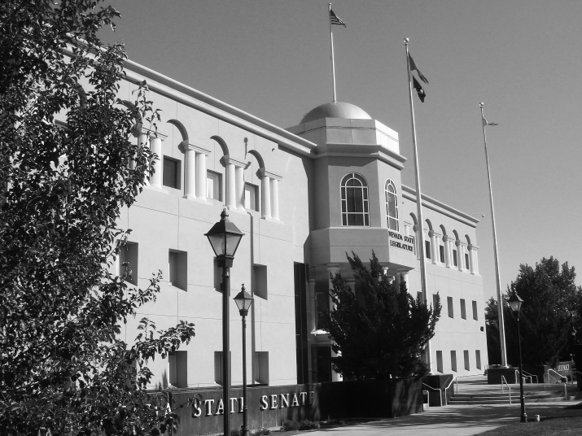
Bill Draft Request
BDR
Most of the Child Welfare and Juvenile Justice policy recommendations that impact statutes have been discussed, vetted and recommended through the Child Welfare/Juvenile Justice Legislative Committee, therefore DCFS has only one BDR for the upcoming Legislative Session that is a housekeeping bill to allow the appropriate agencies to access the Central Registry System

Slide 30
DATA

Slide 31
Avoidable Employee Turnover Rates

Slide 32
Highest Avoidable Turnover Rates
POSITION CLASSIFICATION
TURNOVER REASON

Slide 33
CPS INVESTIGATIONS

Slide 34
Caseworker Contact Compliance

Slide 35
Statewide Foster Care Removals

Slide 36
Statewide Foster Care Removal Rates

Slide 37
Foster Care Licensing Trends

Slide 38
Statewide Average Length of stay in foster care (In Months)

Slide 39
Statewide Adoptions (SFY)

Slide 40
Number of Children Served in Children’s Mental Health

Slide 41
Ages of Children Served Statewide in Children’s Mental Health

Slide 42
Early Childhood Mental Health Services

Slide 43
Children’s Clinical Services/Outpatient

Slide 44
Children’s Mental Health - South

Slide 45
Children’s Mental Health - North

Slide 46
Children’s Wraparound In Nevada (WIN)

Slide 47
Parole Supervision Totals

Slide 48
Daily Populations

